Slide 1
Factors Affecting Motion
By
RABIA
Sports Sciences & Physical Education , LCWU

Slide 2
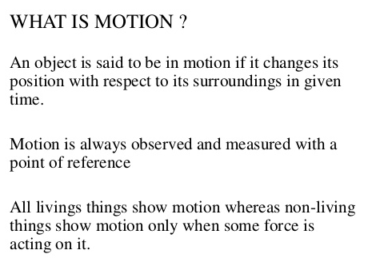
MOTION

Slide 3
BASIC CONCEPTS
Scalar
A quantity which can be defined by its magnitude (or numerical value ) only.
For example
Distance, speed, time, temperature, etc.
Vector
A quantity that has both magnitude and direction.
For example
Displacement, velocity, acceleration, force, etc

Slide 4
BASIC CONCEPTS
Distance
The length of the space between two points. Its unit is meter (m).
It’s a scalar quantity, it has only magnitude.
A football player has 1.8 meter (5ft, 9 inch) height.
Displacement
The minimum distance between two points.
It is an object's change in position, only measuring from its starting position to the final position.
It is vector quantity, it has magnitude and direction.
If your starting and ending position are the same, like in a circular track of 400 meter.
Then your distance is 400 meter while your displacement is 0.

Slide 5
BASIC CONCEPTS
Mass
Quantity of matter in a body is called mass , it is denoted by m and its unit is kg.
It is a scalar quantity, it has only magnitude.
A football player has 75 kg mass (we say weight).
Speed
Speed is the distance traveled per unit of time by an object. It is how fast an object is moving.
It is a scalar quantity, it has no direction.
If an athlete covered a distance of 200 meter in 20 second then its speed is :-
Speed = Distance/time = 200 m/20 s = 10 m/s
Its unit is meter per second (m/s) or Kilometer per hour (km/h)

Slide 6
BASIC CONCEPTS
Velocity
The speed of a body in a particular direction, it is denoted by V, and its unit is meter per second (m/s).
It is a vector quantity, it has both magnitude and direction.
If an object covered a displacement of 20 meters towards east in 2 seconds, then its velocity is:-
Velocity =V = Displacement/time
V= 20 m / 2 s = 10 m/s to east

Slide 7
BASIC CONCEPTS
Acceleration
The rate of change of velocity is called acceleration.
It is also vector quantity.
Its unit is m/s/s or m/s²
Acceleration = a = change in velocity / time to change velocity
Acceleration = a = (V_{f} –V_{i} )/t
V_{f} = final velocity, V_{i} = Initial velocity, t= time
Acceleration due to gravitational
Acceleration due to gravitational force
It is denoted by g, its value is g=9.8 m/s/s or 10 m/s/s

Slide 8
FACTORS AFFECTING MOTION
There four factors that affect the motion of objects
Force
Friction
Inertia
Momentum
Note: Angle of the force determines the direction of the motion of the object

Slide 9
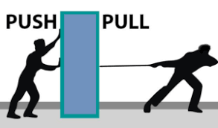
FORCE
A force (F) can be thought of as a push or a pull acting on a body.
Force is characterized by its magnitude, direction, and point of application to a given body. It is a vector quantity.
Body weight, friction, and air or water resistance are all forces that commonly act on the human body.
The action of a force causes a body’s mass to accelerate:
F = ma (F= force, m= mass, a = acceleration)
Units of force are units of mass multiplied by units of acceleration
In the metric system, the most common unit of force is the Newton (N), which is the amount of force required to accelerate 1 kg of mass at 1 m/s ²: 1 N= (1 kg)(1 m/s²)

Slide 10
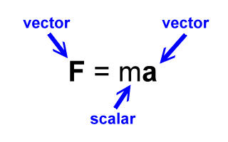
Force Problem
Let's consider an object with a mass of 5 kg, and suppose this object has an acceleration of 3 m/s² , Calculation of its force
Solution
Known Items
m= 5 kg (scalar quantity)
a = 3 m/s/s or m/s ² (vector quantity)
Force =F = m a
F = (5 kg ) (3 m/s²)
=15 kg m/s²
=15 N (vector quantity)

Slide 11
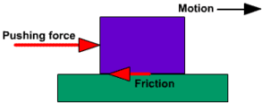
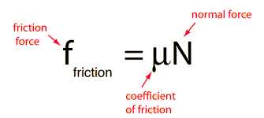
FRICTION
Friction is a force that acts at the interface of surfaces in contact in the direction opposite the direction of motion.
Because friction is a force, it is quantified in units of force (N).
The magnitude of the generated friction force determines the relative ease or difficulty of motion for two objects in contact.
For Example: A box sitting on a level tabletop. The two forces acting on the undisturbed box are its own weight and a reaction force (R) applied by the table.
In this situation, the reaction force is equal in magnitude and opposite in direction to the box’s weight.

Slide 12
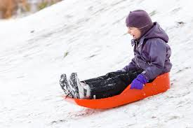
Friction Problem
The coefficient of static friction between a sled (ice hockey) and the snow is 0.18, and coefficient of kinetic friction is 0.15. A 250 N boy sits on the 200 N sled. How much force directed parallel to the horizontal surface is required to start the sled in motion? How much force is required to keep the sled in motion?
Solution
U_{S}= 0.18, U_{k} =0.15, N= normal force = 250+200=450
To start the sled in motion, the applied force must exceed the force of maximum static friction: F_{S}= U N= (0.18) (450)=81 N
To contnue the sled after start, the applied force is equal to
kinetic friction : F_{S}= U N= (0.15) (450)=67.5 N

Slide 13
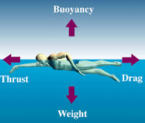
Types of Friction
Fluid Friction
Friction resisting the motion through a fluid, air or gas.
Air resistance is a type of fluid friction.
Sliding Friction
Friction resisting the motion of two objects sliding in opposite directions or across one & other.
Rolling Friction
Friction resisting the motion of a wheel.
Static Friction
Friction between two or more objects that are not moving.

Slide 14
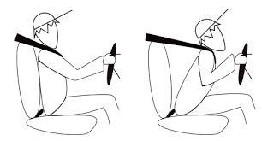
INERTIA
In common usage, inertia means an object's ability to resist changes in motion.
It is the tendency of a body to maintain its current state of rest or motion with a constant velocity until a force slows it down or makes the object change direction.
For example, a 150 kg weight bar lying motionless on the floor has a tendency to remain motionless.
A skater gliding on a smooth surface of ice (snow) has a tendency to continue gliding in a straight line with a constant speed.
Although inertia has no units of measurement, the amount of inertia a body possesses is directly proportional to its mass.
The more mass, the more inertia.

Slide 15
MOMENTUM
Momentum may be defined as the quantity of motion that an object possesses.
A mechanical quantity that is particularly important in situations involving collisions (hit to each other).
Linear momentum is the product of an object’s mass and its velocity: Momentum, M = m v
m=mass (in kg), v =velocity (in m/s).
An object in rest (with zero velocity) has no momentum, M=0;
A change in a body’s momentum may be caused by either a change in the body’s mass or a change in its velocity.
In most human movement situations, changes in momentum result from changes in velocity.
Units of momentum are kg m/s. Momentum is a vector quantity (magnitude & direction).

Slide 16
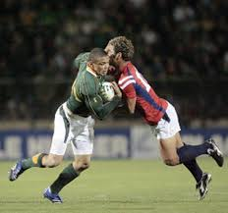
Problem of Momentum
If two object hit to each other, there is a tendency for both objects to continue moving in the direction of motion by the object with the greatest momentum.
If a 90 kg player traveling at 6 m/s to the right collides head-on with an 80 kg player traveling at 7 m/s to the left.
The momentum of the first player is the following:
M =mv =(90 kg) (6 m/s)= 540 kg m/s
The momentum of the second player is:
M=mv =(80 kg) (7 m/s)= 560 kg m/s
Momentum of 2nd player is larger

